Slide 1
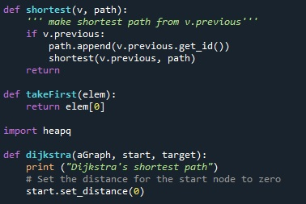
SHORTEST PATH USING DIJKSTRA
Maja Erkechova
Subject: Programming, data structures and algorithms
Professor: Doc. Dr. Anton Biasizzo

Slide 2
INTRODUCTION
The shortest path problem is the classical problem in the graph theory study, aiming to find the shortest path between two nodes in a graph;
Most common algorithms for graph-based shortest path finding: Dijkstra’s Algorithm, Bellman-Ford algorithm, Floyd-Warshall algorithm, Johnson’s algorithm, etc.
Edsger Wybe Dijkstra (1959)
Applied in many fields like robot path planning, guiding driver systems, geographic information science, transportation, etc.

Slide 3



INTRODUCTION
Improvements of the traditional Dijkstra can be categorized in three groups:
to analyze the space complexity of the algorithm and to improve storage efficiency and save space;
to analyze and improve the time complexity; and
to enrich the application field of the algorithm.

Slide 4

DIJKSTRA’S ALGORITHM
For a graph $G = (V, E,W)$ where V are the nodes, E are the edges (that is the path connecting two nodes $v_{i−1}$ and $v_{i}$) and $W$ are the edge weights, a very important thing to note is that Dijkstra places one constraint on the graph: there can be no negative edge weights.
How does Dijkstra’s algorithm work?

Slide 5
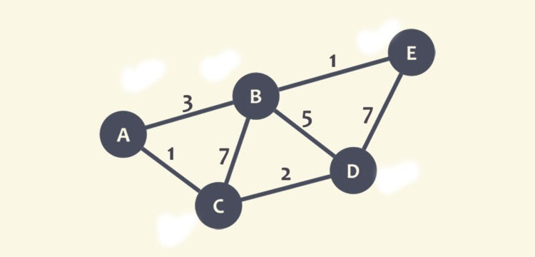
DIJKSTRA’S ALGORITHM

Slide 6
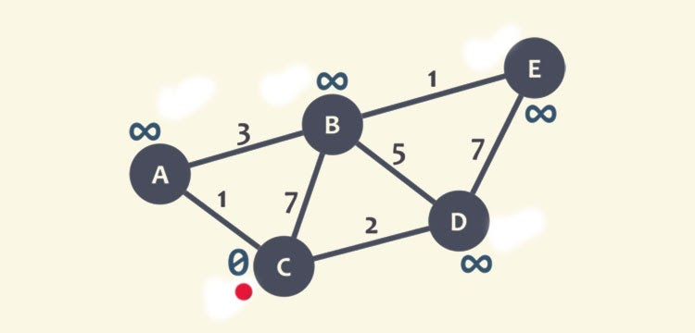
DIJKSTRA’S ALGORITHM

Slide 7
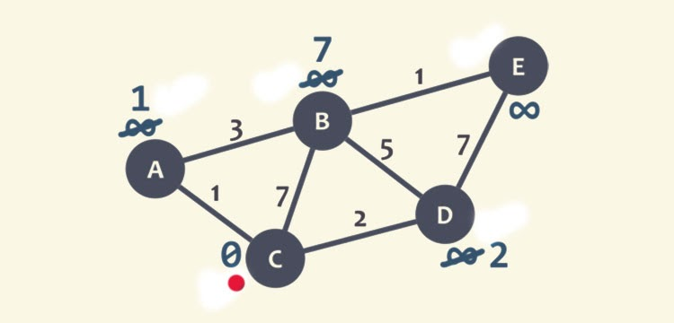
DIJKSTRA’S ALGORITHM

Slide 8
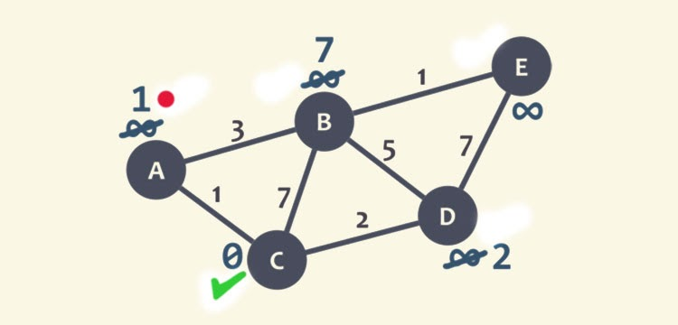
DIJKSTRA’S ALGORITHM

Slide 9
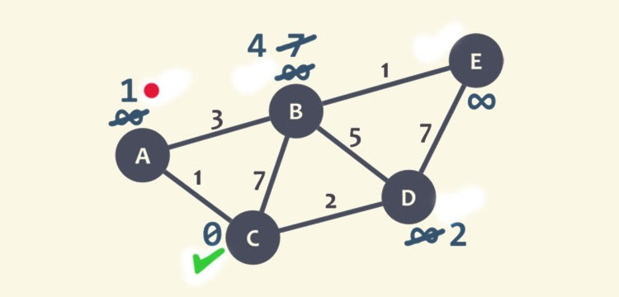
DIJKSTRA’S ALGORITHM

Slide 10
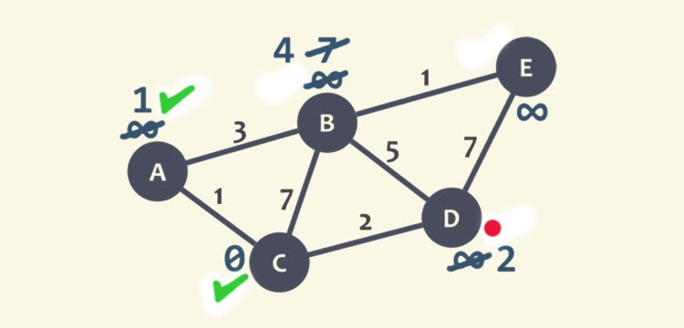
DIJKSTRA’S ALGORITHM

Slide 11
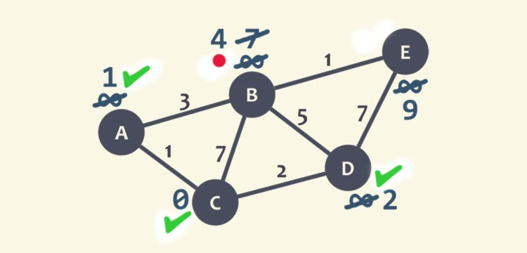
DIJKSTRA’S ALGORITHM

Slide 12
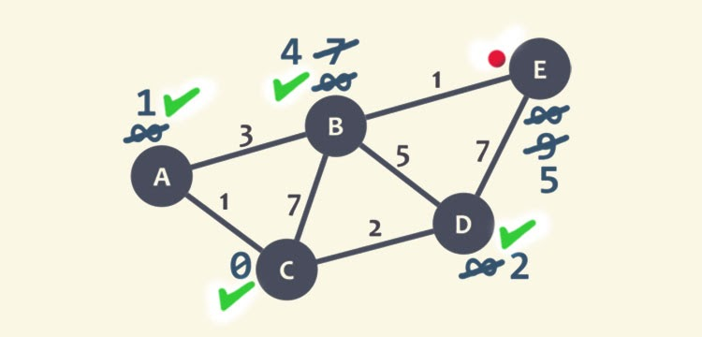
DIJKSTRA’S ALGORITHM

Slide 13
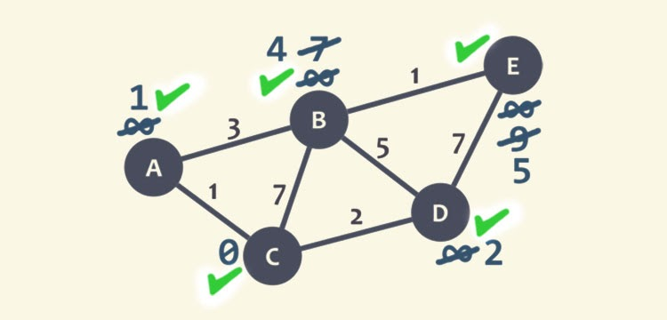
DIJKSTRA’S ALGORITHM
shortest path found: C-A-B-E with a distance of 5

Slide 14
OTHER SHORTEST PATH ALGORITHMS
The Bellman-Ford algorithm also finds the shortest path but it is slower than Dijkstra, although it can handle graphs in which some of the edge weights are negative.
The Floyd-Warshall algorithm calculates the shortest distance between every pair of nodes in the graph rather than only calculating from a single node. This one is typically faster on dense graphs.
Johnson’s algorithm on the other hand varies from the rest algorithms as it relies on two other algorithms to determine the shortest path. First, it uses Bellman-Ford to detect negative cycles and eliminate any negative edges. Then, it relies on Dijkstra’s algorithm to calculate the shortest path.

Slide 15
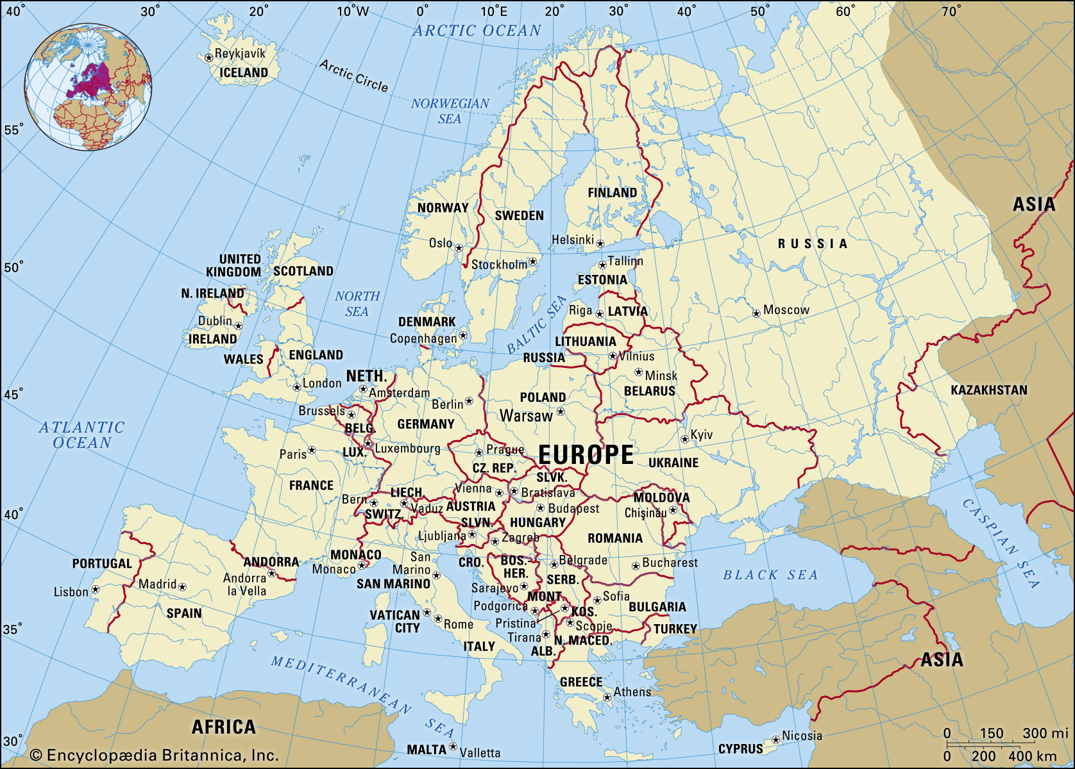
EUROPE TRIP PROBLEM

Slide 16
OTHER SHORTEST PATH ALGORITHMS
The Smith family who is planning a two months tour across Europe for the summer holidays. The father, Joseph, just bought a new car and he is looking forward to testing its performance out and enjoying driving it along the trip. Their starting city is Rome, where they currently live, and the destination city is Stockholm. As they recently moved to Europe and do not know much about the capitals nor which would they like to visit, they are open to options but they would like to see the shortest route so they can spend more time visiting the cities and less time driving.

Slide 17
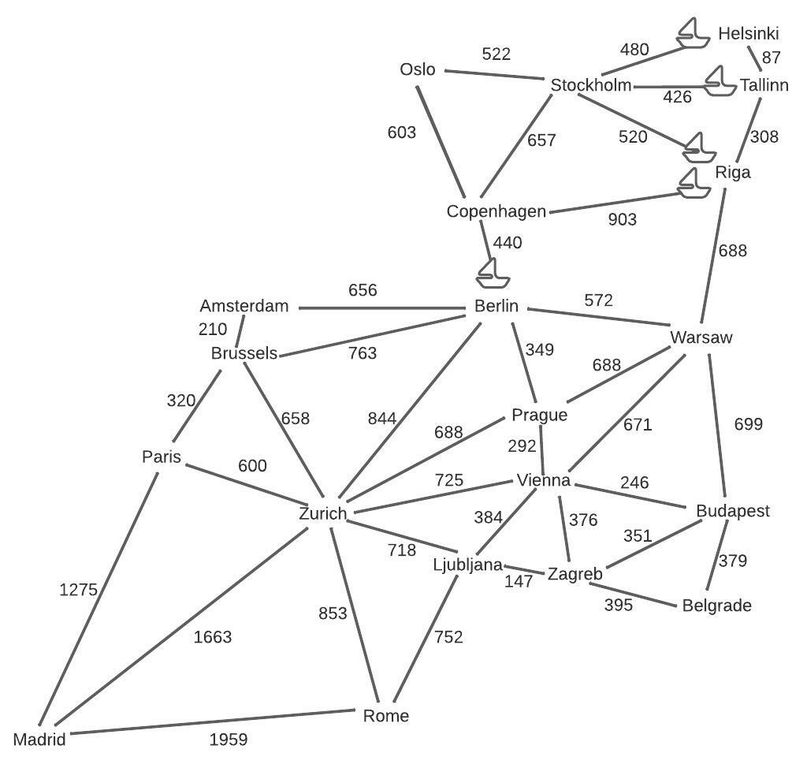
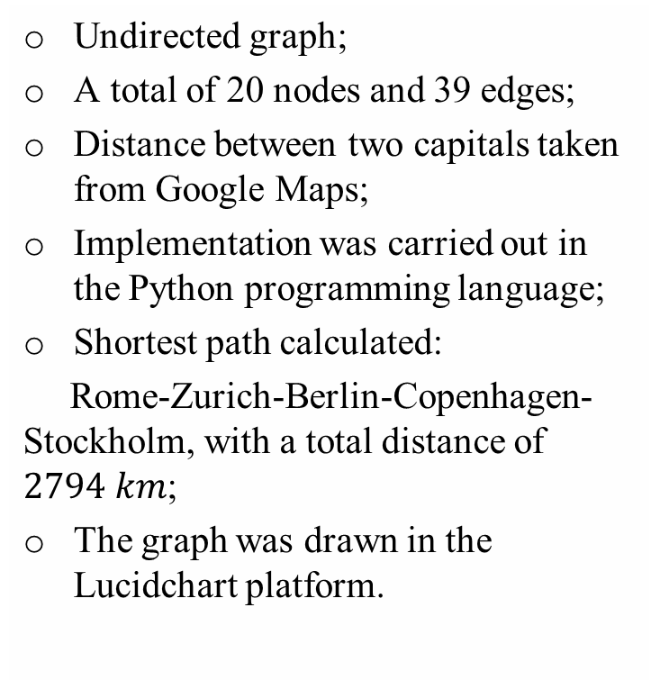
IMPLEMENTATION
Undirected graph;
A total of 20 nodes and 39 edges;
Distance between two capitals taken from Google Maps;
Implementation was carried out in the Python programming language;
Shortest path calculated:
Rome-Zurich-Berlin-Copenhagen- Stockholm, with a total distance of $2794 km$;
The graph was drawn in the Lucidchart platform.

Slide 18
IMPLEMENTATION
Dijkstra’s running time depends on how the operations are implemented;
A priority queue is an abstract data type which is like a regular queue or stack data structure, but it differs from the “first come first served” policy with the additional priority in which the elements are served, and in this case the priority the lower distance between the nodes.
A heap is a kind of binary tree, where each node, except for the root node, has a parent node. Heaps are known for its maximally efficient implementation of a priority queue
 | Running time
Priority queue | 0.004996 seconds
heapq | 0.002999 seconds
Already very short running time
Heapq shortens the time in half

Slide 19
DISCUSSION
Constraints:
Add a limitation to the number of nodes in the shortest path;
Add a limitation to the total distance (that is the total edge weight); (Although both ideas are contradictory from Dijkstra’s algorithm core logic to simply find the shortest path between the start and destination node and another algorithm may be a more suitable option, this is an interesting area that can be a focus of future work for this study);
Give two more path options along with the shortest path.

Slide 20
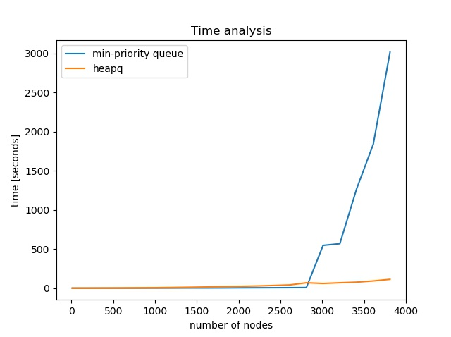
TIME ANALYSIS
The running time clearly increases with the increase of the number of nodes in the graphs;
A strange condition occurring for the running time of 3210 nodes;
The results of the time analysis corroborated with the results of the Europe trip example.
Although, in real-life problems, there would be many more nodes and the traditional Dijkstra algorithm may be seen as a shoddy option, it is still an excellent foundation with a lot of space for improvement and advancement.

Slide 21
CONCLUSION
With the focus on the Dijkstra algorithm, this study covers the basics and provides an example using the algorithm to solve the shortest path Europe trip problem and a discussion for the time complexity for randomly generated graphs. Although, in real-life problems, there would be many more nodes and the traditional Dijkstra algorithm may be seen as a shoddy option, it is still an excellent foundation with a lot of space for improvement and advancement.

Slide 22
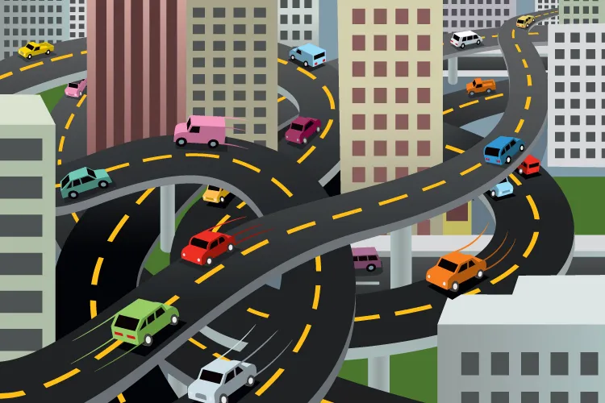
THANK YOU!

