Slide 1
Maximum Flow in Graphs
Jozef Stefan International Postgraduate School
ICT2 – Programming, Data Structures and Algorithms
Student: Matic Kladnik
Supervisor: prof. dr. Anton Biasizzo
April 2022

Slide 2
Introduction
Maximum flow in graph or network: an optimization problem
Goal: Find a feasible flow through a network and obtain maximum possible flow rate
Similar to minimum capacity problem
Applications: water delivery, traffic in computer networks, logistics, etc.

Slide 3
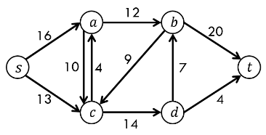
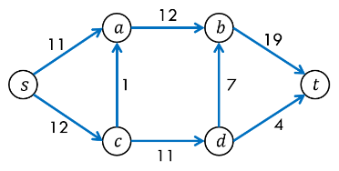
Description
Vertices (nodes)
edges
Given directed graph: G = (V, E)
Each edge e has a capacity, where c(e) > 0
Source node (s) and sink node (t)
Goal: maximize the amount of flow from s to t within capacity constraints
Notes:
Sink node can also be known as target node

Slide 4
Ford-Fulkerson Algorithm
initialize flow to 0 path = findAugmentingPath(G, s, t) while path exists: augment flow along path G_f = createResidualGraph() path = findAugmentingPath(G_f, s, t) return flow
In its original form the algorithm is not defined in detail
Augmenting flow along the path can be implemented in a inefficient way
Residual graphs used to find augmenting paths between s and t
Note: search algorithm is not defined (BFS, DFS, …)

Slide 5
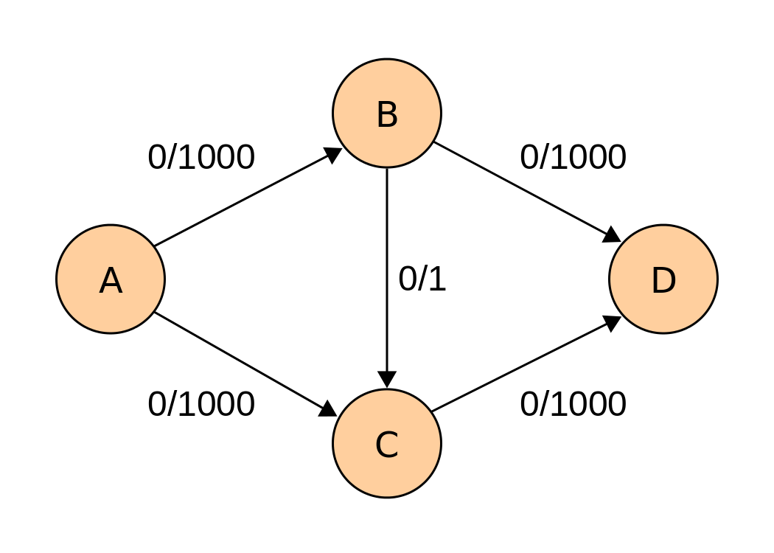
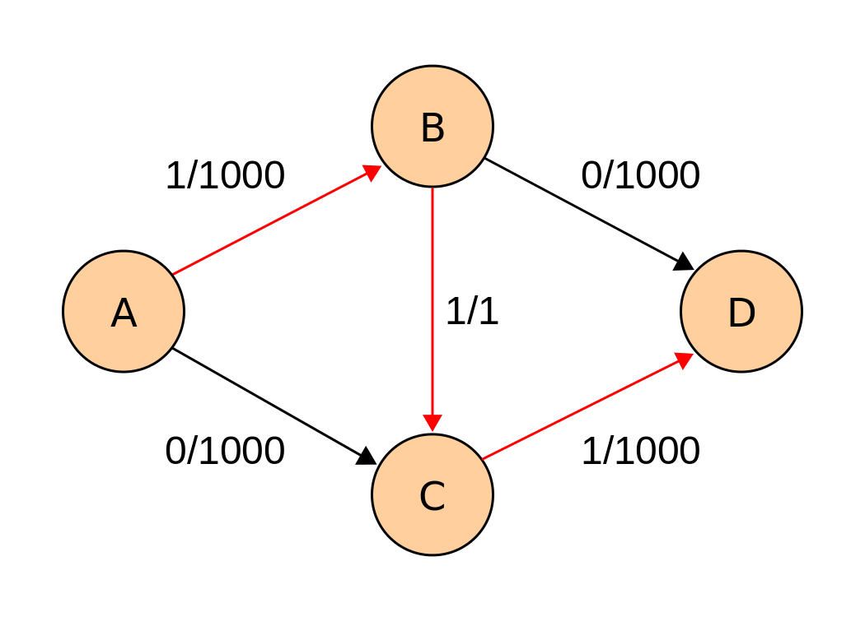
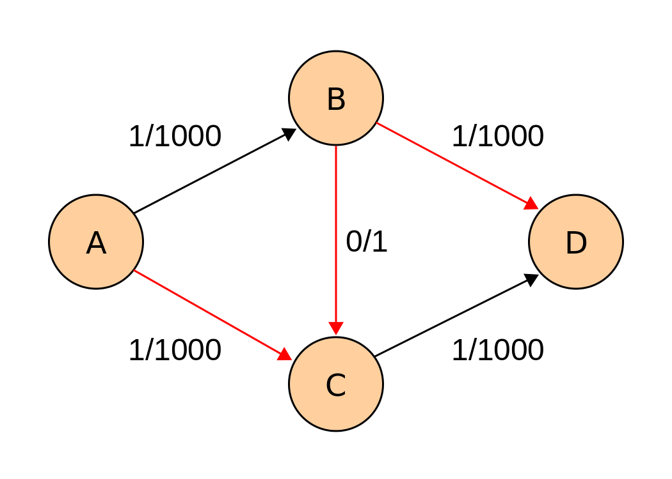
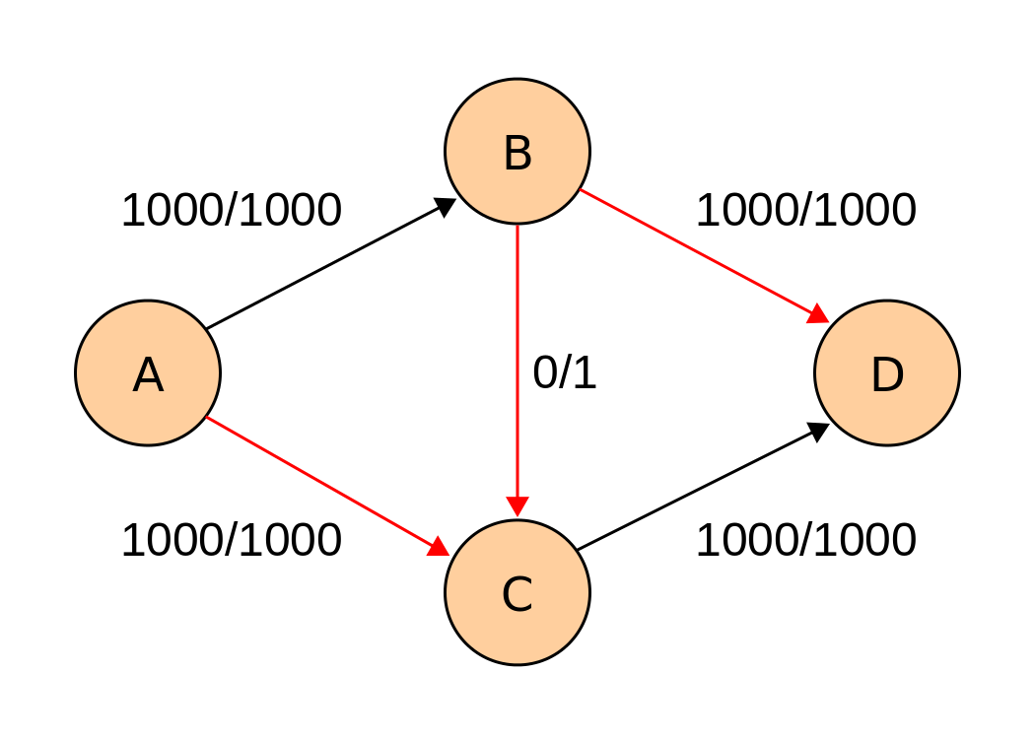
Inefficient augmentation of flow
s (source): A
t (sink): D
We do not find the shortest path in each iteration
…
…
final step:

Slide 6
Ford-Fulkerson in more detail
Improved pseudocode with more details
flow = 0 for each edge (u, v) in G: flow(u, v) = 0
while there is a path, p, from s -> t in residual network G_f: residual_capacity(p) = min(residual_capacity(u, v) : for (u, v) in p) flow = flow + residual_capacity(p) for each edge (u, v) in p: if (u, v) is a forward edge: flow(u, v) = flow(u, v) + residual_capacity(p)
else:
flow(u, v) = flow(u, v) - residual_capacity(p)
return flow

Slide 7
Simulating Ford-Fulkerson
1) Input graph
2) Find a path
3) Update residual capacities
4) Find next path
5) Update residual capacities

Slide 8
By taking reverse edges into account we make sure to find the theoretical maximum flow: 4 + 2 = 6
6) Find next path
7) Update residual capacities

Slide 9
Edmonds-Karp Algorithm
An improved, well defined implementation of Ford-Fulkerson
We use Breadth-First Search as the searching algorithm: we get the shortest path in each iteration
Inputs:
C: Capacity Matrix
E: Adjacency Matrix
s: Source node index
t: Sink node index

Slide 10
Edmonds-Karp Algorithm - pseudocode
Edmonds-Karp: f = 0 // Flow is initially 0 F = [n x n] // residual capacity array while true: m, P = Breadth-First-Search(C, E, s, t, F) if m = 0: break f = f + m v = t while v != s: u = P[v] F[u, v] = F[u, v] – m // reducing the residual capacity of the augmenting path F[v, u] = F[v, u] + m // increasing the residual capacity of the reverse edges v = u
return f
Notes:
inputs C[n x n] : Capacity Matrix E[n x n] : Adjacency Matrix s : source t : sink output f : maximum flow

Slide 11
Comparison of algorithm complexities
Ford-Fulkerson: O(|E| f_max)
|E|: number of edges in the graph
f_max: maximum flow in the graph
Edmonds-Karp: O(|V| |E|²)
|V|: number of vertices (nodes)
Each iteration is bound by O(|E|)
There are at most |V| |E| iterations
More efficient in graphs with large flows

Slide 12



Overview of our implementation
Instead of using both, adjacency and capacity matrices, we can use a merged adjacency matrix
Matrix representation of graph
Based on Edmonds-Karp
E: Adjacency Matrix
C: Capacity Matrix
$$\left[\begin{matrix}0 & 1 & 1 & 0 \\ 0 & 0 & 1 & 1 \\ 0 & 0 & 0 & 1 \\ 0 & 0 & 0 & 0\end{matrix}\right]$$
$$\left[\begin{matrix}0 & 1000 & 1000 & 0 \\ 0 & 0 & 1 & 1000 \\ 0 & 0 & 0 & 1000 \\ 0 & 0 & 0 & 0\end{matrix}\right]$$
Joined adjacency matrix with capacities
$$\left[\begin{matrix}0 & 1000 & 1000 & 0 \\ 0 & 0 & 1 & 1000 \\ 0 & 0 & 0 & 1000 \\ 0 & 0 & 0 & 0\end{matrix}\right]$$

Slide 13
Additional information of our implementation
Done in Python with type hints
Minor optimizations:
Initializing the list to hold path only once (we do not need the old state of the path in the new iteration)
We use adjacency matrix as the residual matrix as we add reverse edges

Slide 14
Dinic’s Algorithm
Also known as Dinitz’s algorithm
Very fast in practice (especially on large graphs), especially efficient on bipartite graphs
Key concepts:
Level graph: distance (number of edges) of each node to the source node
Residual flow graph: defines max capacities on edges
Augmenting path: path of edges in a residual graph with some (>0) unused capacity (bottleneck value – smallest capacity on the path)
Augmenting the flow: updating flow values of edges along the augmenting path
Level graph created with a BFS (Breadth-First Search) approach

Slide 15
Dinic’s Algorithm in more Detail
G = ((V, E), c, f, s ,t c(u,v) – capacity, f(u,v) - flow G_f – residual graph G_L – level graph 1) Set f(e) = 0 for each e in E 2) Construct G_L from G_f of G. If dist(t) = Inf -> stop and output f. 3) Find a blocking flow f’ in G_L 4) Add augment flow f by f’ and return to step 2)
Complexity: O(V^2 E)
V – vertices
E – edges
In a bipartite matching problem, the number of phases is bound by O(sqrt(V)), leading to time complexity of O(sqrt(V) E)
Similar as before we use adjacency matrix with capacities in our implementation
Notes:
c(u,v) – capacity, f(u,v) - flow G_f – residual graph G_L – level graph

Slide 16
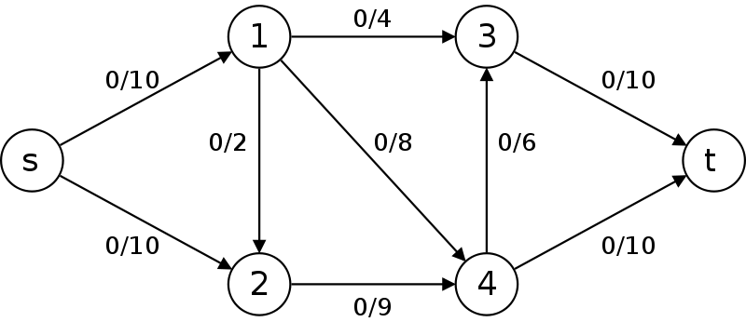
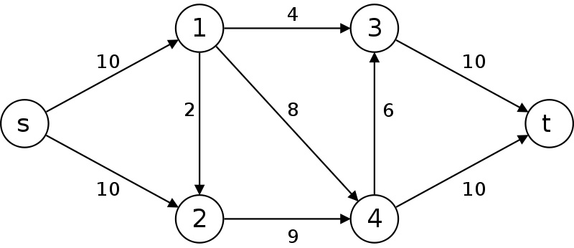
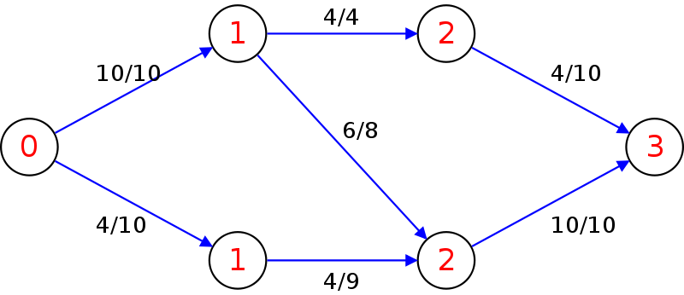

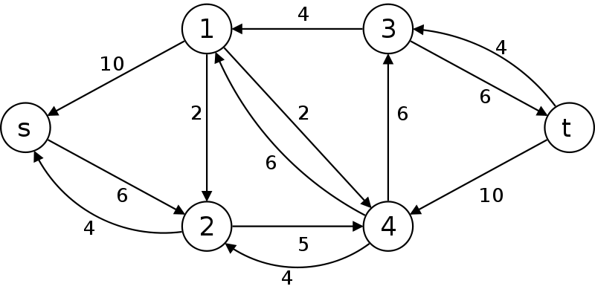
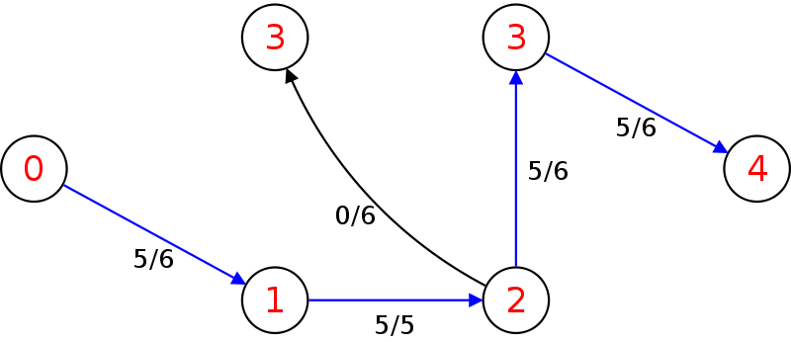

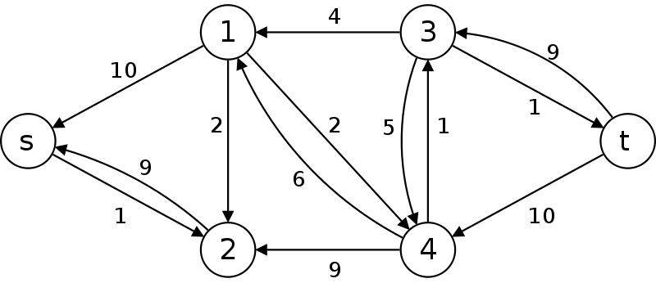
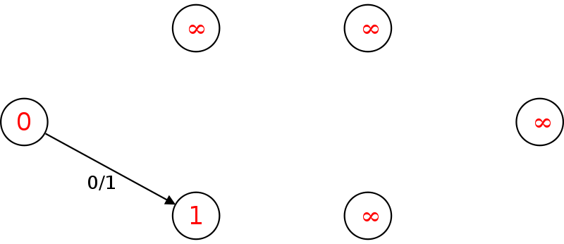
Simulation of Dinic’s Algorithm
G G_f G_L
Notes:
The following is a simulation of Dinic's algorithm. In the level graph G L {\displaystyle G_{L}} , the vertices with labels in red are the values dist ⁡ ( v ) {\displaystyle \operatorname {dist} (v)} . The paths in blue form a blocking flow.
STEP 1
The blocking flow consists of
{ s , 1 , 3 , t } {\displaystyle \{s,1,3,t\}} with 4 units of flow,
{ s , 1 , 4 , t } {\displaystyle \{s,1,4,t\}} with 6 units of flow, and
{ s , 2 , 4 , t } {\displaystyle \{s,2,4,t\}} with 4 units of flow.
Therefore, the blocking flow is of 14 units and the value of flow | f | {\displaystyle |f|} is 14. Note that each augmenting path in the blocking flow has 3 edges.
STEP 2
The blocking flow consists of
{ s , 2 , 4 , 3 , t } {\displaystyle \{s,2,4,3,t\}} with 5 units of flow.
Therefore, the blocking flow is of 5 units and the value of flow | f | {\displaystyle |f|} is 14 + 5 = 19. Note that each augmenting path has 4 edges.
STEP 3
Since t {\displaystyle t} cannot be reached in G f {\displaystyle G_{f}} , the algorithm terminates and returns a flow with maximum value of 19. Note that in each blocking flow, the number of edges in the augmenting path increases by at least 1.

Slide 17
Conclusion
We have various application uses for maximum-flow problems
Edmonds-Karp improvement of Ford-Fulkerson alg., can be more efficient on smaller graphs (networks)
Dinic’s algorithm especially efficient on large and bipartite graphs
Various other approaches, including linear programming, Dinic with dynamic trees, push-relabel algorithm
Different algorithms can perform better on certain types of graphs

Slide 18
Questions?

