Slide 1
Segment trees: simple, dynamic, and persistent
Seminar presentation for data structures and algorithms course
M.Besher Massri
April 2022

Slide 2
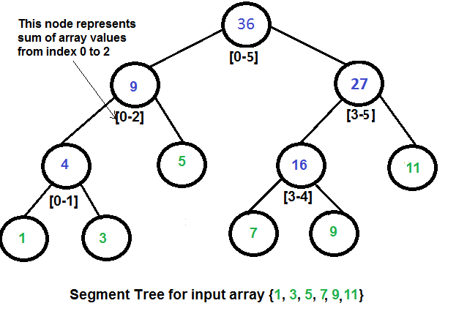
Segment trees
Binary tree
Each node is either a leaf or has exactly two children
Each node store precalculated value about a consecutive range in the array
Each node range is the combination of its children’ ranges
Leaf nodes responsible for a single element.
Height is ceil(log N)
Used to answer queries about ranges of array.
Operations supported are operations with associative properties e.g. sum/min/max etc.

Slide 3
Data representation
Segment trees can be represented as a tree with pointers to left and right children
A more efficient representation uses indices of the array.
A node at index (x), has a left child at (x*2), right child at (x*2+1), and a parent at floor(x/2).
The range of each node can also be calculated on the fly.
Root responsible for entire range: l=0, r=n-1
Left child has first half, from l to (l+r)/2
Right child has second half, from (l+r)/2+1 to r

Slide 4
Merge function
Merge function is used to calculate the node value from the value of the left and right children.
It’s also used to combine partial results in query function
The merge function is problem dependent.

Slide 5
Build function
Initialization of the segment tree
Values of the nodes are calculated based on the initial values of the array and the target operation.

Slide 6
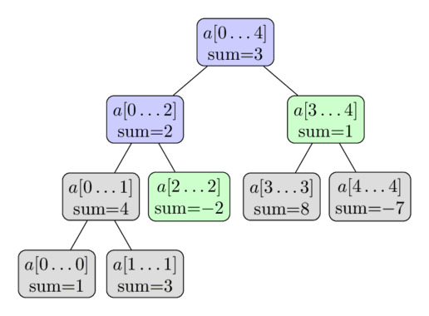
Query function
Query function answer the query of a certain operation on a target range.
For each node, if it’s completely covered within the target range, return its value
Otherwise, if the target range is completely covered within its left or right child’s ranges, return the answer from that child.
Otherwise, calculate recursively from each child and combine the values.

Slide 7
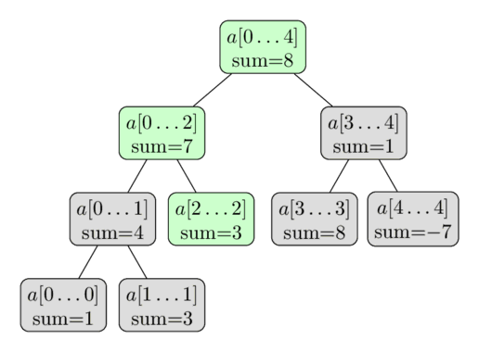
Single point update
Update an element requires updating all nodes covering it.
A single item is covered by Log N nodes at most, one at each level
Updates start at the leaf, and propagate to the top.
Merge function is used to update the nodes values.

Slide 8
Range updates and lazy propagation
Range updates might require changing large number of nodes, which is costly.
Key observation 1: we can avoid re-calculating each node unless we have to, i.e. it’s accessed during query.
Key observation 2: a value of a node that has all items changed, can be updated immediately without updating sub-children. Moreover, such updates can be stacked and combined.
A value of the node needs to be up-to-date when used during query.
Lazy propagation is used to apply the changes to the current node, and push those cached updates to its direct nodes.

Slide 9
High dimensional segment trees
Segment trees can be applied on higher dimensional vectors
2D segment tree on a matrix can answer queries on any sub-rectangle of the matrix.
With high dimensions, extra cost of time and space is required.

Slide 10
Dynamic segment trees
Instead of dealing with existing arrays, segment trees can be built on a set of items with operations like add/remove/update/query.
Such operations can be implemented by having a large segment tree with values covering the range of values of the elements: MIN…MAX
Such segment tree can be pretty large.

Slide 11
Dynamic segment trees (2)
Key idea is to start with a hypothetical tree covering all range, with only root created, and create children as required.
Adding an element is similar to single-point update, but we create new nodes along the way if none exists.
Query is performed similarly, with careful consideration for handling empty branches.
Extra variables for storing pointers to left and right children are required

Slide 12
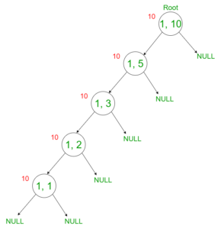
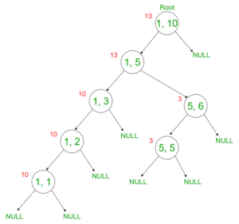
Dynamic segment trees (3)

Slide 13
Persistent segment trees
Persistence data structures enable accessing past state of the data structure.
Partial persistent data structures allows read-only of past states, and read/write of current state.
Fully persistent data structures allows for read/write of current and past state.
Persistent segment trees are fully persistent data structures that enables updating/querying at different points in time.

Slide 14
Persistent segment trees (2)
In persistent segment trees, we only create another copy of the nodes we want to update, and maintains links to unmodified children.
Each version will have its own root, which connects it to the rest of the tree representing the data structure at that version.
Extra variables for storing pointers to left and right children are required.

Slide 15
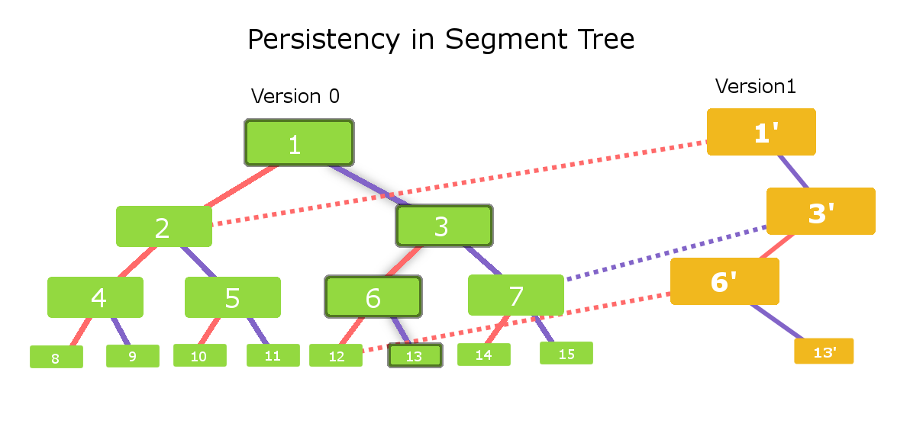
Persistent segment trees (3)

Slide 16
Task 1
Given an array of N elements A, perform two types of operations:
Add X to each element A[i] where l<=i<=r
Calculate the sum of A[i] where l<=i<=r
N<=10^5
N.operations <=10^5
A[i]<=10^9
=> Range sum, range update

Slide 17
Task 2
Given an array of N elements A.
Answer queries of the form, l, r, k: considering the items A[i], l<=i<=r. What is the kth smallest item?
N<=10^5
N.queries <=10^5
A[i]<=10^9
=> persistent segment tree on frequency array

Slide 18
Thank you!
Questions ???

